Slide 1



Data Mining DSC550-T301 Project.SBenavidez
View in Power BI
Last data refresh:
3/4/2023 5:46:10 PM UTC
Downloaded at:
3/4/2023 7:10:50 PM UTC

Slide 2
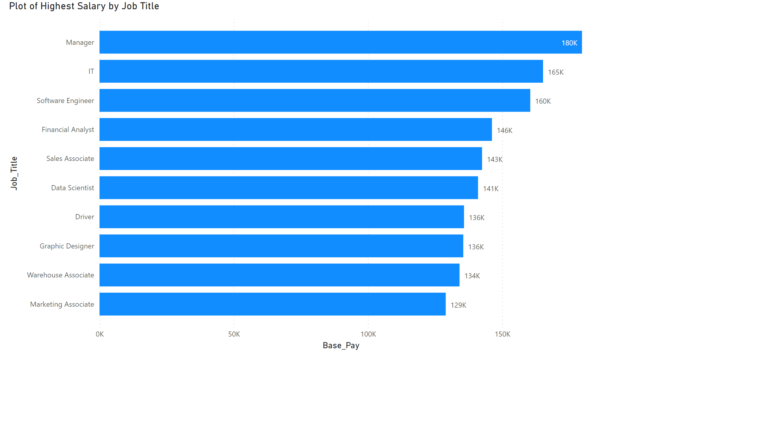
Plot of Highest Salary
Notes:
Plot of Highest Salary by Job Title
No alt text provided

Slide 3
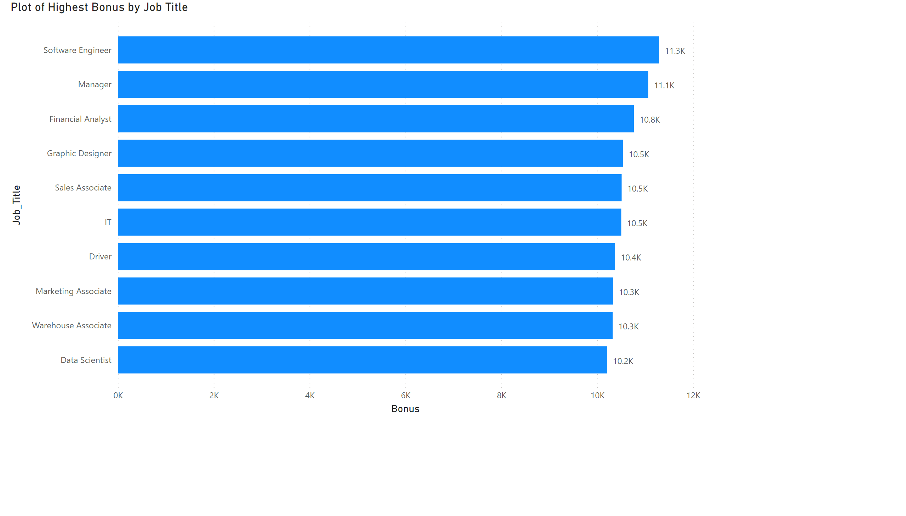
Plot of Highest Bonus
Notes:
Plot of Highest Bonus by Job Title
No alt text provided

Slide 4
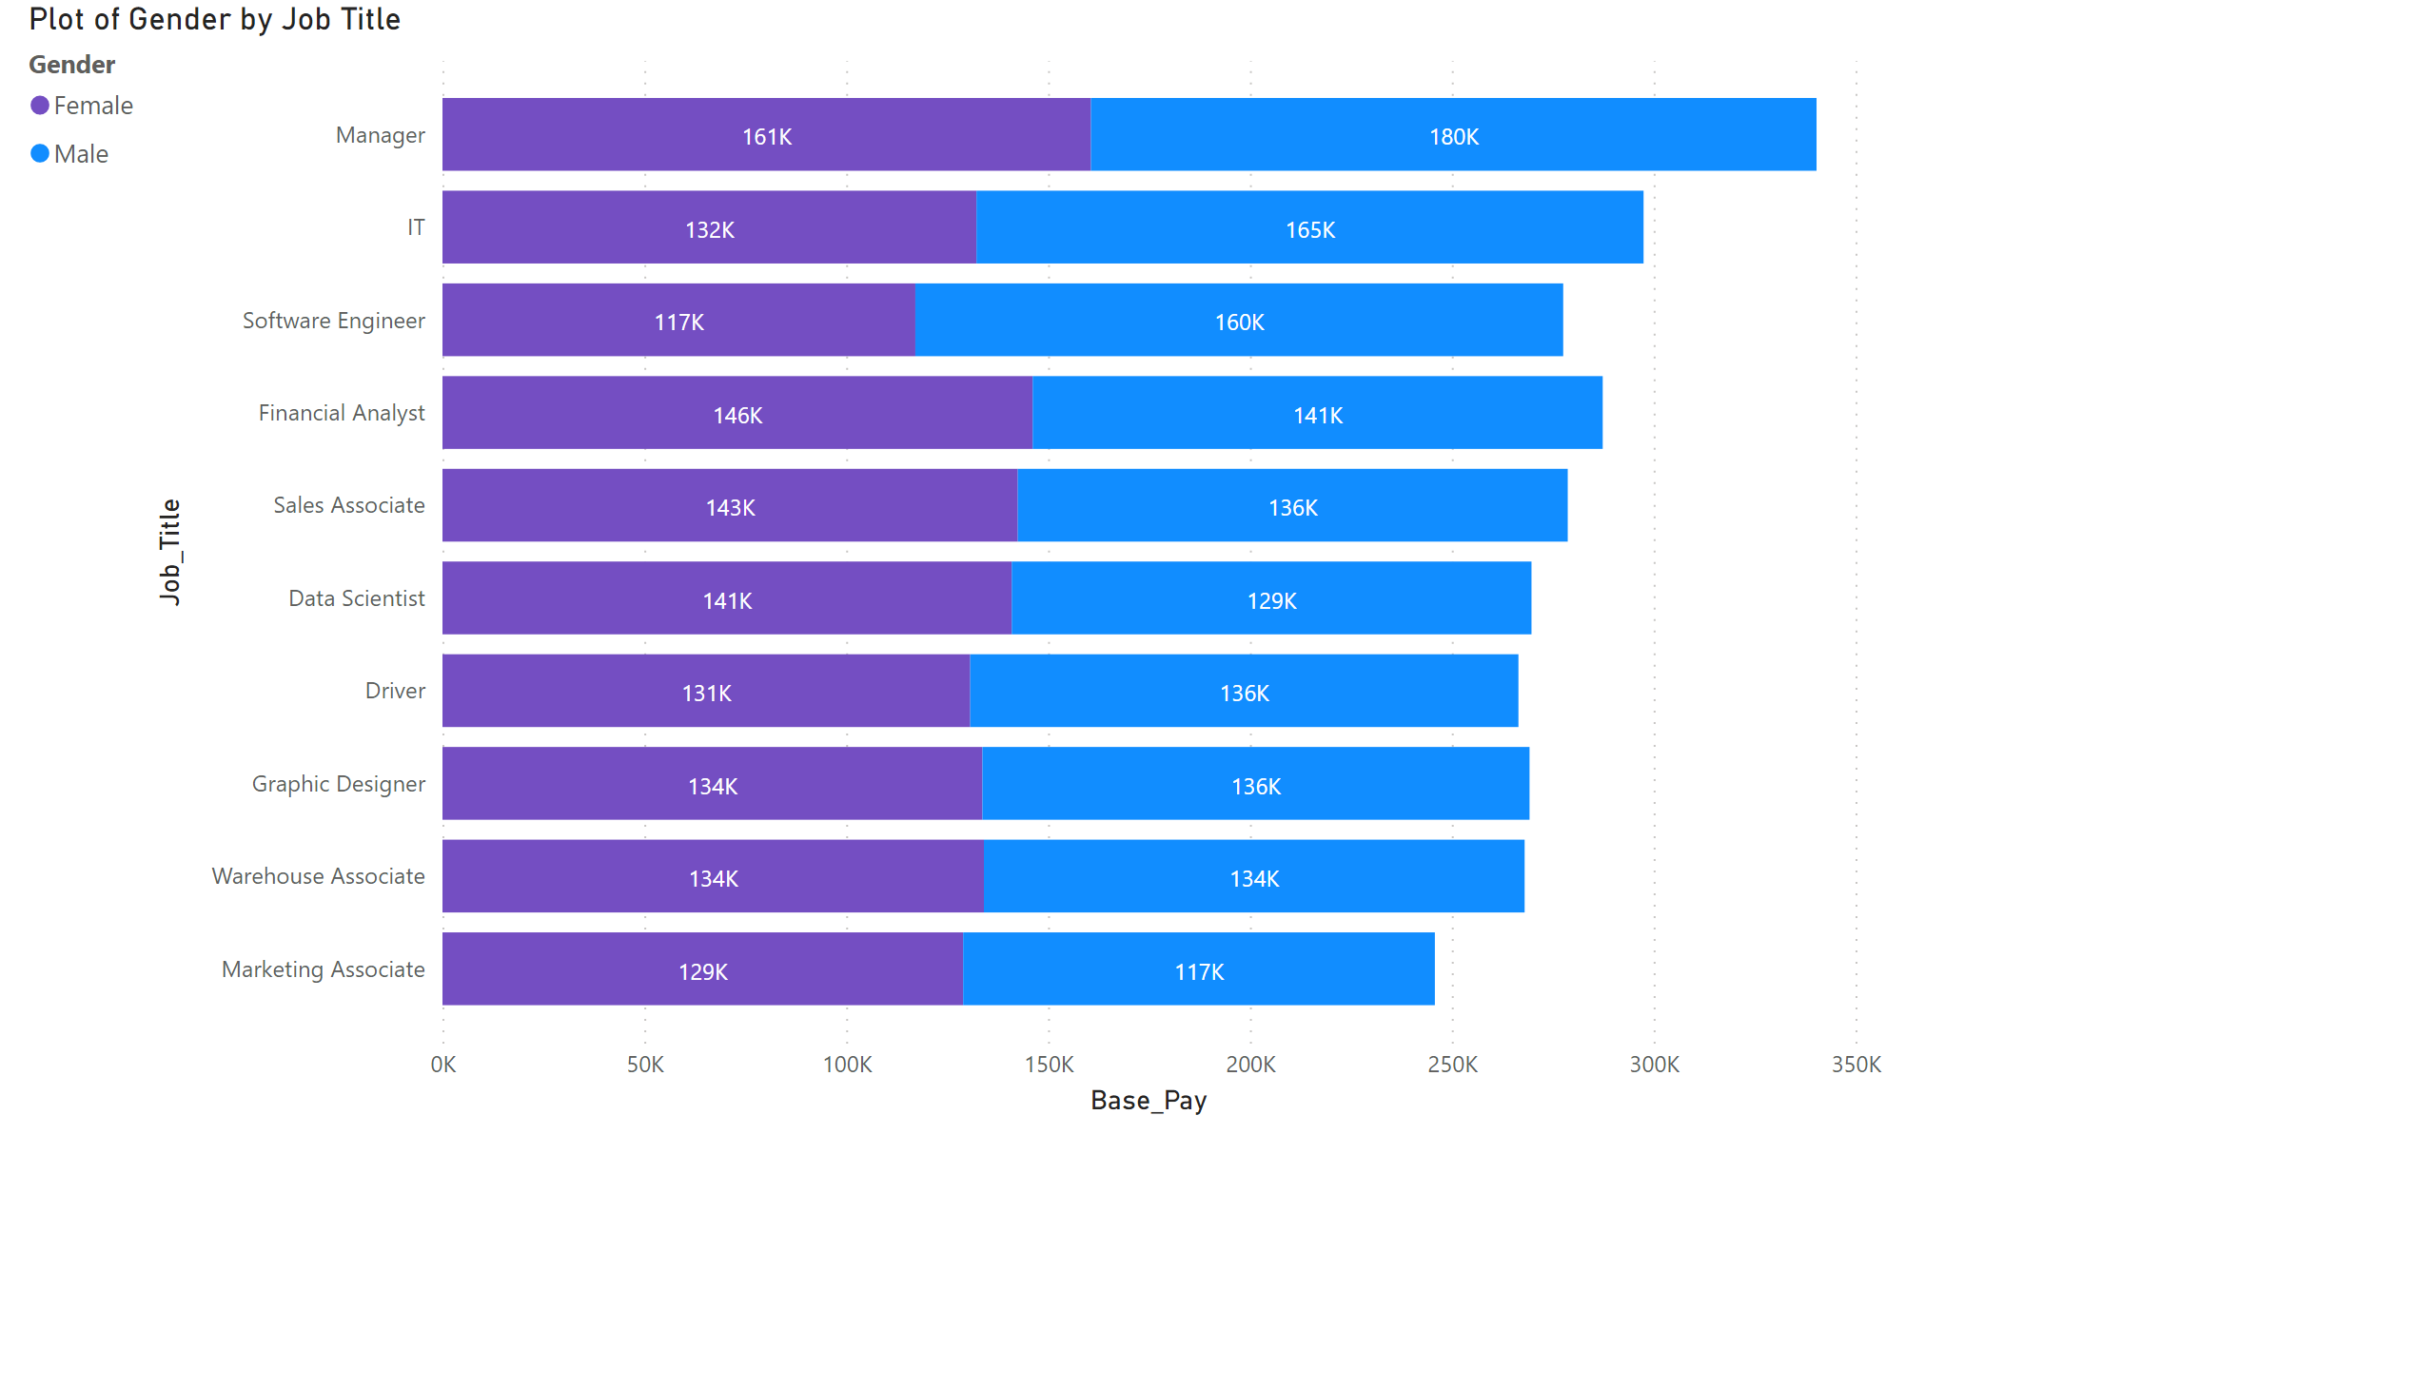
Plot of Gender by Job Title
Notes:
Plot of Gender by Job Title
No alt text provided

Slide 5
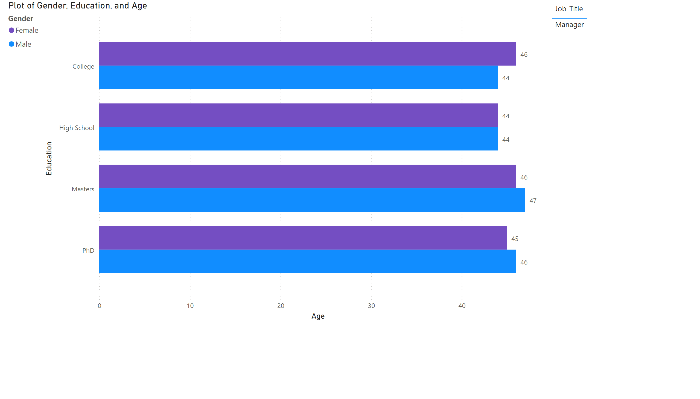
Plot of Gender and Education
Notes:
tableEx
No alt text provided
Plot of Gender, Education, and Age
No alt text provided

Slide 6
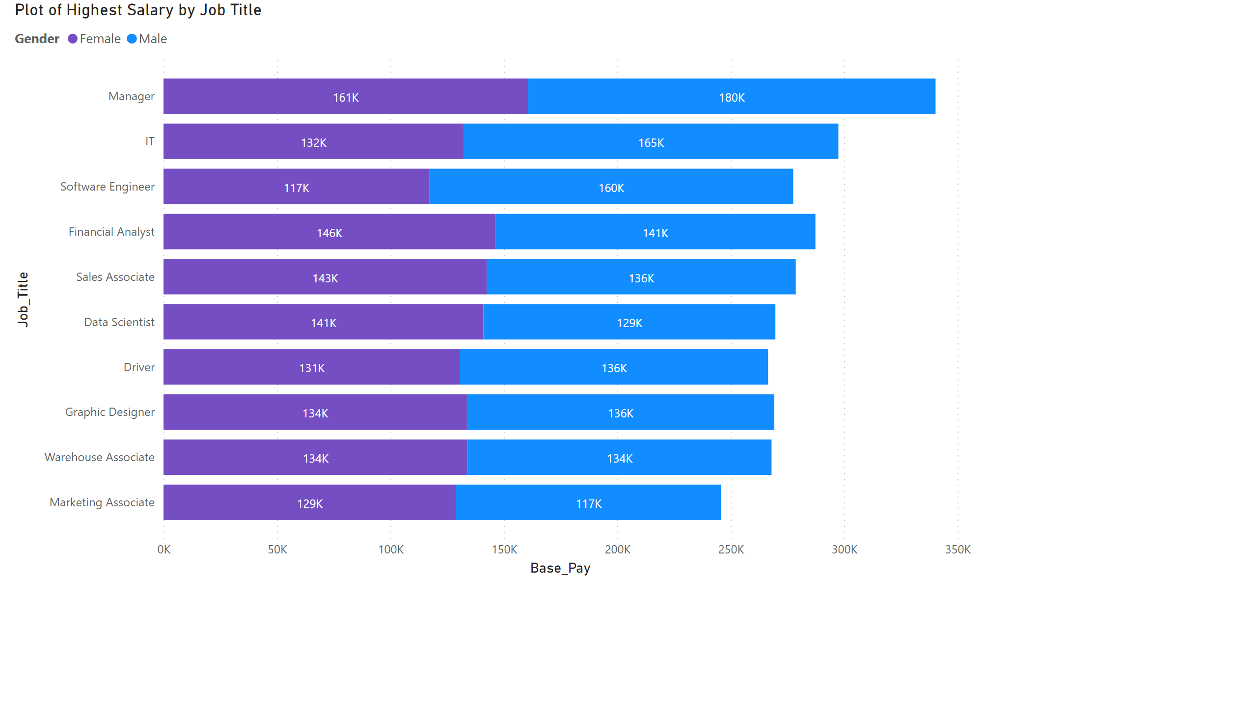
Plot of Highest Salary by Gender
Notes:
Plot of Highest Salary by Job Title
No alt text provided

Slide 7
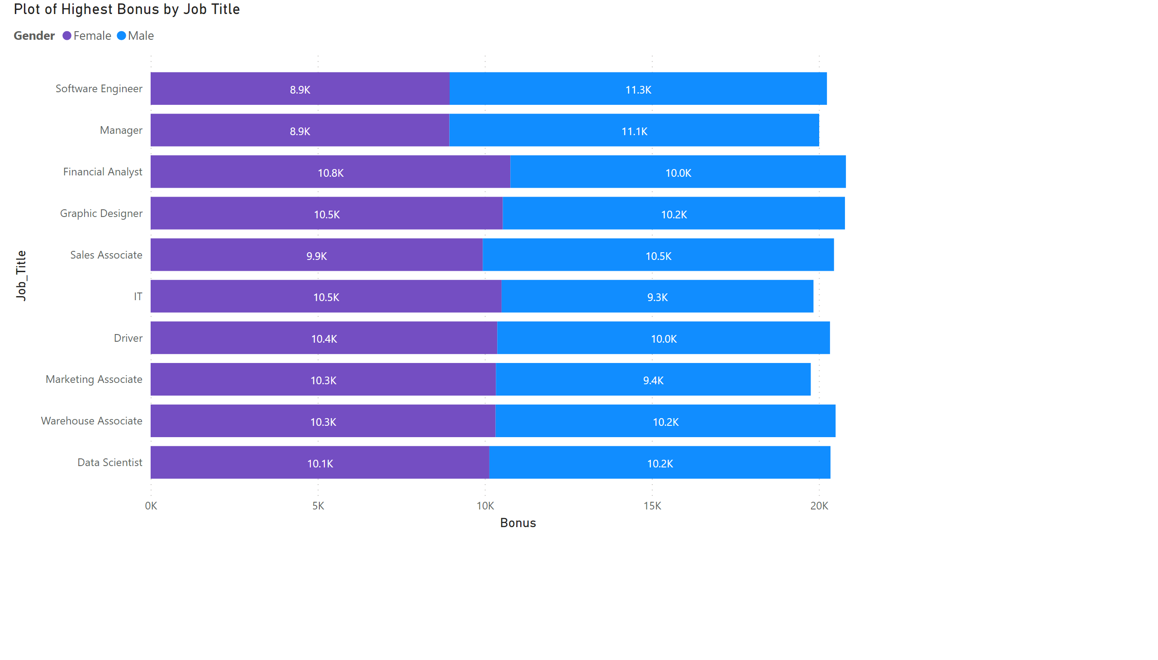
Plot of Highest Bonus by Gender
Notes:
Plot of Highest Bonus by Job Title
No alt text provided

